Slide 1

Cloud Adoption Framework (CAF)

Slide 2
Microsoft Cloud Adoption Framework for Azure
Adopt
Define strategy
Understand motivations
Business outcomes
Business justification
Prioritize project
Plan
Digital estate
Initial organization alignment
Skills readiness plan
Cloud adoption plan
Ready
Azure setup guide
First landing zone
Expand the blueprint
Best practice Validation
Migrate
• First workload migration
• Expanded scenarios
• Best practice validation
• Process improvements
Innovate
• Innovation guide
• Expanded scenarios
• Best practice validation
• Process improvements
Govern
Methodology • Benchmark
initial best practice • Governance maturity
Manage
Business commitments
operations baseline • Ops maturity

Slide 3
Define Strategy
Document your cloud strategy to help stakeholders understand the business outcomes the organization is pursuing by adopting the cloud
1
Motivations
Understand motivations to move to cloud
2
Business Outcomes
Engage stakeholders to document specific business outcomes
3
Business Justification
Develop a business justification that supports your motivations and outcomes
4
Identify First Project
Leverage business and technical criteria to choose your first project

Slide 4
Plan
Cloud adoption plans convert the aspirational goals of the cloud adoption strategy into actions. It will help guide technical efforts, in alignment with the business strategy.
1
Rationalize Digital estate
Rationalize your digital estate to determine best approach to cloud adoption
2
Initial org alignment
Align governance and cloud adoption to mitigate risks
3
Skills readiness plan
Get your people ready by identifying skills gap and plan
4
Cloud adoption plan
Create an actionable cloud adoption plan that aligns to your business strategy

Slide 5
Ready
Ready establishes a cloud foundation or adoption target that can provide hosting for any adoption efforts.
1
Azure setup guide
Azure setup guidance in the Cloud Adoption Framework
2
First landing zone
Leverage the Cloud Adoption Framework migrate landing zone blueprint
3
Expand the blueprint
Use the landing zone considerations to enhance the blueprint template
4
Best practices
Validate landing zone modifications against best practices

Slide 6
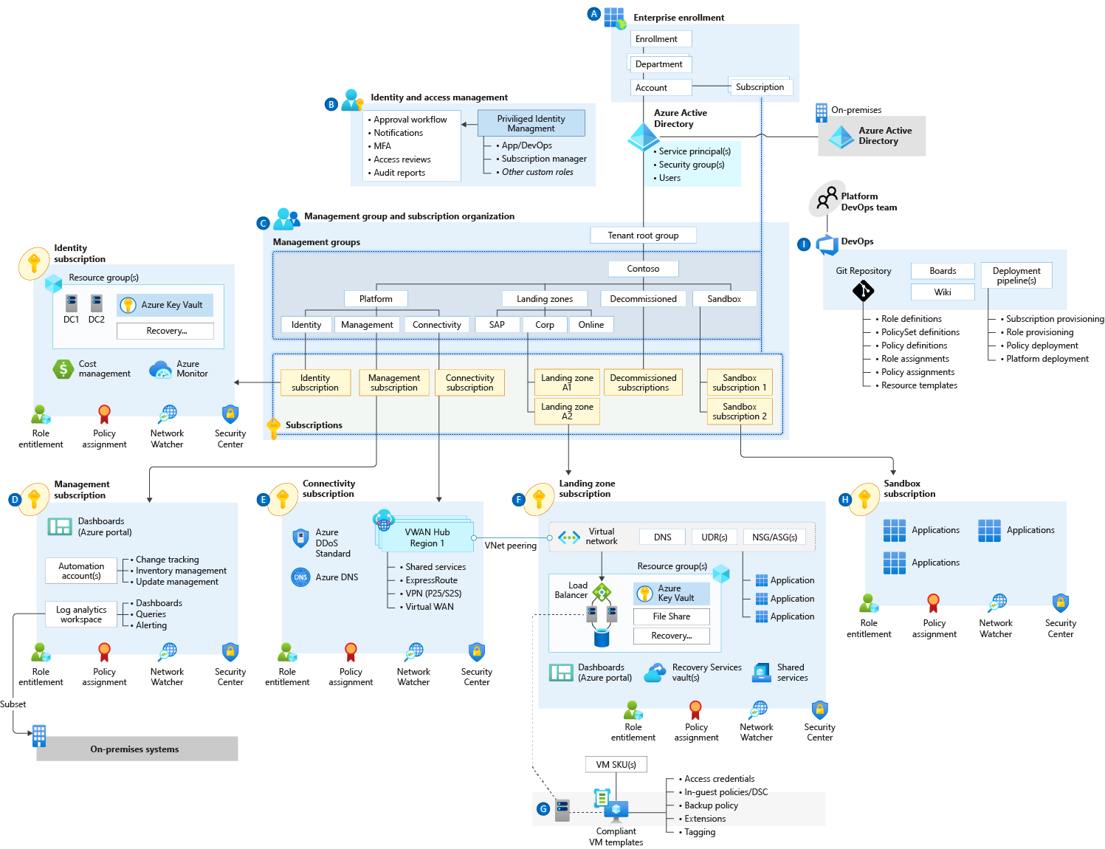
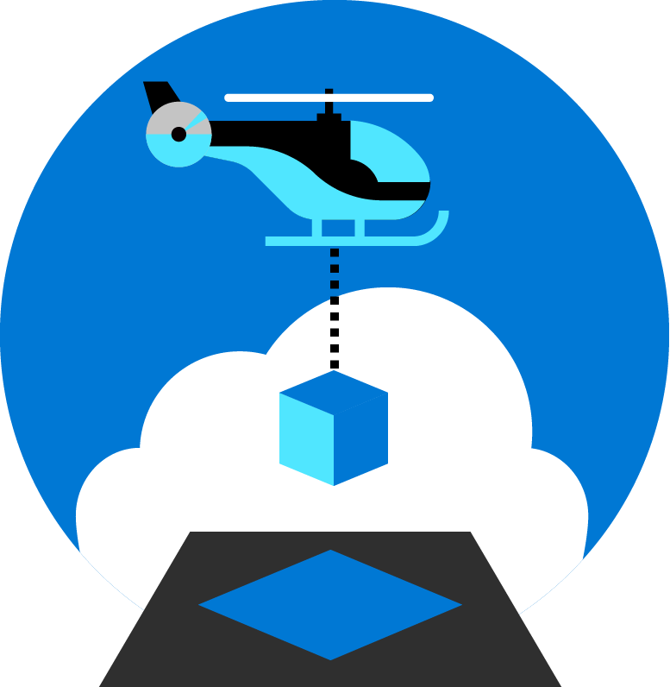
Azure Landing Zones
Notes:
Azure Landing Zones is an architecture approach and reference implementation that enables effective construction and operationalization of landing zones on Azure, at scale and aligned with the Azure roadmap and the Microsoft Cloud Adoption Framework for Azure. The Azure Landing Zones architecture provides prescriptive guidance coupled with Azure best practices, and it follows design principles across the critical design areas for the customer's Azure environment.

Slide 7
Azure Landing Zones Design Principles
Subscription Democratisation
Policy Driven Governance
Single Control and Management Plane
Application Centric and Archetype-Neutral
Azure Native Design and Platform Roadmap Alignment
Enable Autonomy for Innovation and Transformation
Security and Compliance By-Default
Governance At-Scale with Sustainable Cloud Engineering
https://github.com/azure/enterprise-scale
Notes:
Just like organizing book in library comes with set of principals. Azure Landing Zones comes with set of design principals, which are necessary for organizing resources in subscriptions. There is a purpose behind every single principal which will be discussed during this presentation.
Subscriptions should be used as a unit of management and scale aligned with business needs and priorities. You should avoid to maintain central control for subscription creation, and allow business units to create subscriptions themselves. Your governance model should ensure that as subscriptions are created and moved to different management groups, policies are applied to enforce any necessary guardrails.
Azure Policy should be used to provide the “guard-rails” and ensure the continued compliance of the customer platform and applications deployed onto it, whilst also providing application owners sufficient freedom and a secure unhindered path to cloud.
The Azure Landing Zones architecture should NOT rely on abstraction layers such as customer developed portals or tooling, and should provide a consistent experience for both AppOps (centrally managed operation teams) and DevOps (dedicated application operation teams).
The Azure Landing Zones architecture should focus on application centric migrations and development rather than a pure infrastructure “lift and shift” migration (i.e. movement of virtual machines) and should not differentiate between old/new applications or IaaS/PaaS applications.
The Azure Landing Zones architecture strongly advocates the use of native platform services and capabilities wherever possible, which should be fully aligned with Azure platform roadmaps from the offset to ensure new capabilities are swiftly made available within customer environments.
the use of native platform services and capabilities wherever possible, which should be fully aligned with Azure platform roadmaps from the offset to ensure new capabilities are swiftly made available within customer environments.

Slide 8

Azure landing zones Design areas
Azure billing & Azure Active Directory tenant
Security
Identity & access management
Governance
ENVIRONMENT
COMPLIANCE
Resource organization
Management
Network topology & connectivity
Platform automation & DevOps
Notes:
Design areas (the different parts that make up Azure landing zones) are an important early step in thinking about and designing a landing zone.
Azure billing an Active Directory tenant - Proper tenant creation, enrolment, and billing setup are important early steps.
Identity and access management - Identity and access management is a primary security boundary in the public cloud. It's the foundation for any secure and fully compliant architecture.
Resource organization - As cloud adoption scales, considerations for subscription design and management group hierarchy have an impact on governance, operations management, and adoption patterns.
Network topology and connectivity - Networking and connectivity decisions are an equally important foundational aspect of any cloud architecture.
Security - Implement controls and process to protect your cloud environments
Governance - Automate auditing and enforcement of governance policies.
Management - For stable, ongoing operations in the cloud, a management baseline is required to provide visibility, operations compliance, and protect and recover capabilities.
Platform automation and DevOps - Align the best tools and templates to deploy your landing zones and supporting resources.
Split into Environment and Compliance:
Build vs Run
Starting points vs on-going iterations and refinements
Let's look at how we approach an understanding of how a cloud operating model works.

Slide 9




Azure Well-Architected
Build and manage high-performing workloads
Azure
Well-Architected
Review
Build workloads with confidence with proven practices
Reliability
Design
Principles
Azure
Advisor
Cost Optimization
Design high-performing workloads using deep technical guidance
Azure
Well-Architected
Framework
Operational Excellence
Performance Efficiency
Reference
Architectures
Documentation
Security
Optimize workloads with actionable areas of focus
Partners, Support &
Services Offers
Notes:
With Azure Well-Architected, build workloads with confidence based on proven deep technical guidance, that is actionable and simple-to-use, and helps you identify where to focus efforts for workload optimization.​
​
Well-Architected enables you to achieve:
Build with confidence across all workload deployments and operations against.
Design workloads using actionable and simple-to-use deep technical guidance.
Perform gap analysis to identify areas of improvement, and where to focus optimization efforts.
The Framework = the center of an ecosystem (best practices, documentation, assessments, reference architectures, and design principles).
Ecosystem is amplified by partner and services offers to help you improve workload quality.​
​
Azure Well-Architected Framework enables you to achieving your business objectives, operationalizing how to design, build, and optimize cloud solutions.​
Microsoft Azure Well-Architected Review provides evaluates workloads with gap analysis and identifies areas of where to focus your optimization efforts.​
Reference Architectures help you to build and deploy any workload to scale and meet your business needs.​
Design principles based on proven practices and design patterns from successful customer and partner deployments.​
Microsoft Partner & Service Offers support you—and help you build effective cloud solutions.​
Let's look at how to overcome inhibitors to workload quality.

Slide 10
Best Practices for Swiss Banks
Andre Heim, Partner Technology Strategist
Francisco Teles, Cloud Solution Architect

Slide 11
Principles behind Best Practices for Swiss Banks
Enterprise-Scale Landing Zones
Zero Trust Principles
Identity and Access Management Principles
Notes:
Key Takeaway: Zero Trust focuses on the original mission of security (keeping assets out of the control of attackers) with a fresh strategic perspective
The IT environments we run have been complex since their early days, composed of many devices, user identities, and interactions between them
CLICK 1 – We tried “Trusted Networks” protected by a security perimeter (#2)
As the attacks started to emerge on our IT systems, the first thing we tried in IT Security was to adapt the concept of a security perimeter from military doctrine. This tactic worked at first and seemed to be a good simple solution to the problem because most productivity at the time was done in the office on physical corporate networks (desktops, servers, mainframes, and terminals)
CLICK 2 – But that didn’t hold up over time (#3 and #4)
Over time, the world of productivity grew with mobile devices, WiFi, cloud services, and remote productivity. At the same time, security threats expanded into a full spectrum of attacker motivations (criminal, nation-state espionage, hacktivism, and more) and continuously adds new creative attack techniques to get around this network perimeter consistently.
These two factors eroded the underlying assumptions that everything to be protected is on the corporate network. The network security perimeter tactic started to fail to meet the strategic needs of the organization.
Security needed a comprehensive security strategy to guide and prioritize how to deal with this new complexity (which incorporates network security perimeters where appropriate), a strategy we now call Zero Trust.

Slide 12
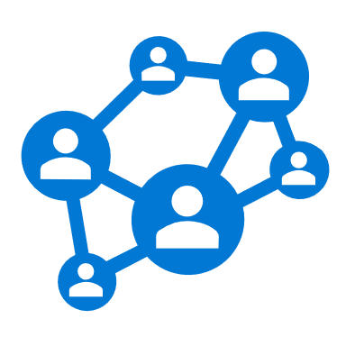




Why are we having a Zero Trust conversation?
Keep Assets away from Attackers
IT Security is Complex
Many Devices, Users, & Connections
“Trusted network” security strategy
Initial attacks were network based
Seemingly simple and economical
Accepted lower security within the network
Assets increasingly leave the network
BYOD, WFH, Mobile, and SaaS
Attackers shift to identity attacks
Phishing and credential theft
Security teams often overwhelmed
Notes:
Key Takeaway: Zero Trust focuses on the original mission of security (keeping assets out of the control of attackers) with a fresh strategic perspective
The IT environments we run have been complex since their early days, composed of many devices, user identities, and interactions between them
CLICK 1 – We tried “Trusted Networks” protected by a security perimeter (#2)
As the attacks started to emerge on our IT systems, the first thing we tried in IT Security was to adapt the concept of a security perimeter from military doctrine. This tactic worked at first and seemed to be a good simple solution to the problem because most productivity at the time was done in the office on physical corporate networks (desktops, servers, mainframes, and terminals)
CLICK 2 – But that didn’t hold up over time (#3 and #4)
Over time, the world of productivity grew with mobile devices, WiFi, cloud services, and remote productivity. At the same time, security threats expanded into a full spectrum of attacker motivations (criminal, nation-state espionage, hacktivism, and more) and continuously adds new creative attack techniques to get around this network perimeter consistently.
These two factors eroded the underlying assumptions that everything to be protected is on the corporate network. The network security perimeter tactic started to fail to meet the strategic needs of the organization.
Security needed a comprehensive security strategy to guide and prioritize how to deal with this new complexity (which incorporates network security perimeters where appropriate), a strategy we now call Zero Trust.

Slide 13
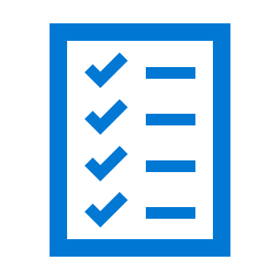

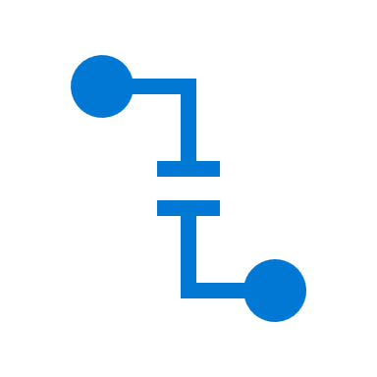
Microsoft Zero Trust Principles Guidance for technical architecture
Verify explicitly
Use least privilege access
Assume breach
Always validate all available data points including
User identity and location
Device health
Service or workload context
Data classification
Anomalies
To help secure both data and productivity, limit user access using
Just-in-time (JIT)
Just-enough-access (JEA)
Risk-based adaptive polices
Data protection against out of band vectors
Minimize blast radius for breaches and prevent lateral movement by
Segmenting access by network, user, devices, and app awareness.
Encrypting all sessions end to end.
Use analytics for threat detection, posture visibility and improving defenses
Notes:
Key Takeaway: These are Microsoft’s Zero Trust Principles

Slide 14



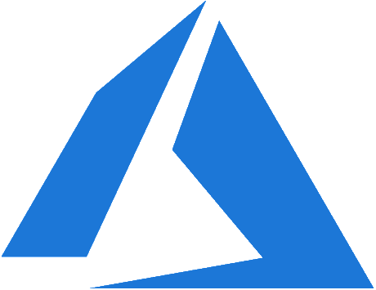








Microsoft Zero Trust Capabilities
Posture Management
Identities
Applications
Continuous risk assessment & Automation
Microsoft Defender for Cloud
Microsoft Azure AD
Conditional Access
Threat intelligence & Telemetry
Data
Zero Trust policy enforcement
Microsoft Defender for Identity
Microsoft Information Protection
Azure Active Directory (Azure AD)
Infrastructure
Endpoints
Microsoft Conditional Access
Azure AD B2B & B2C
Microsoft Defender
Microsoft Defender for Cloud Apps
Network
Microsoft Endpoint Manager
Microsoft Sentinel
Notes:
Key Takeaway: This is a summary of how Microsoft technologies work together to apply Zero Trust principles to Access Control

Slide 15




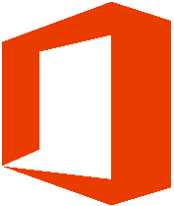

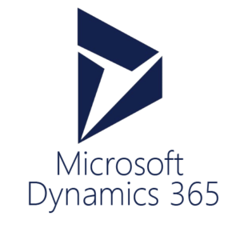
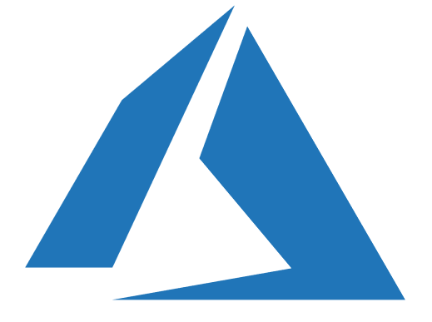

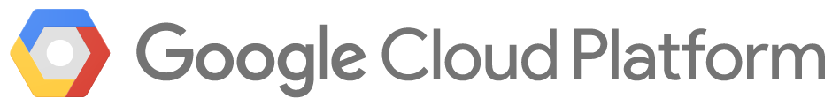
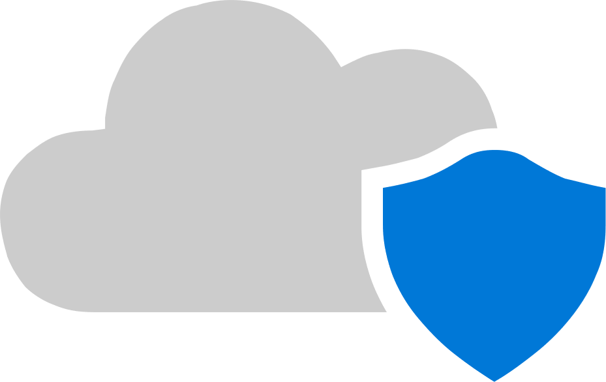




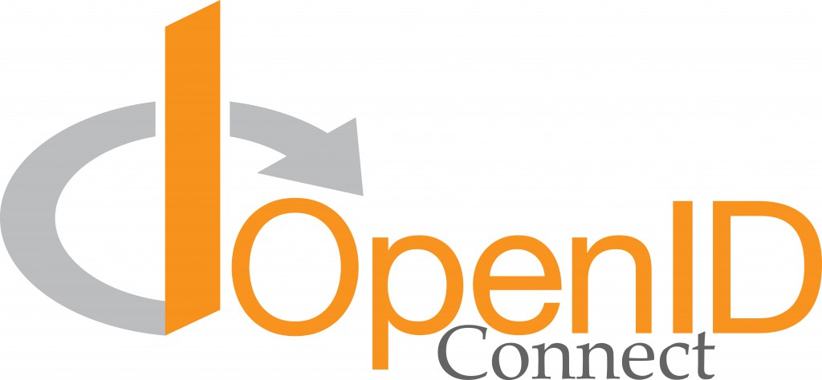
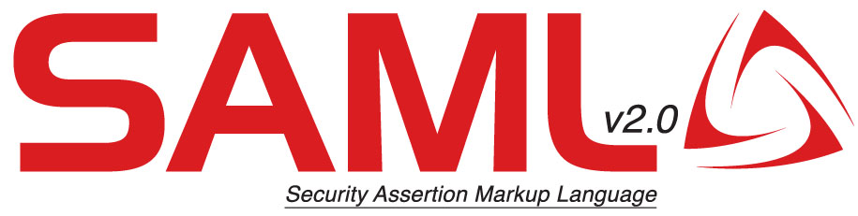









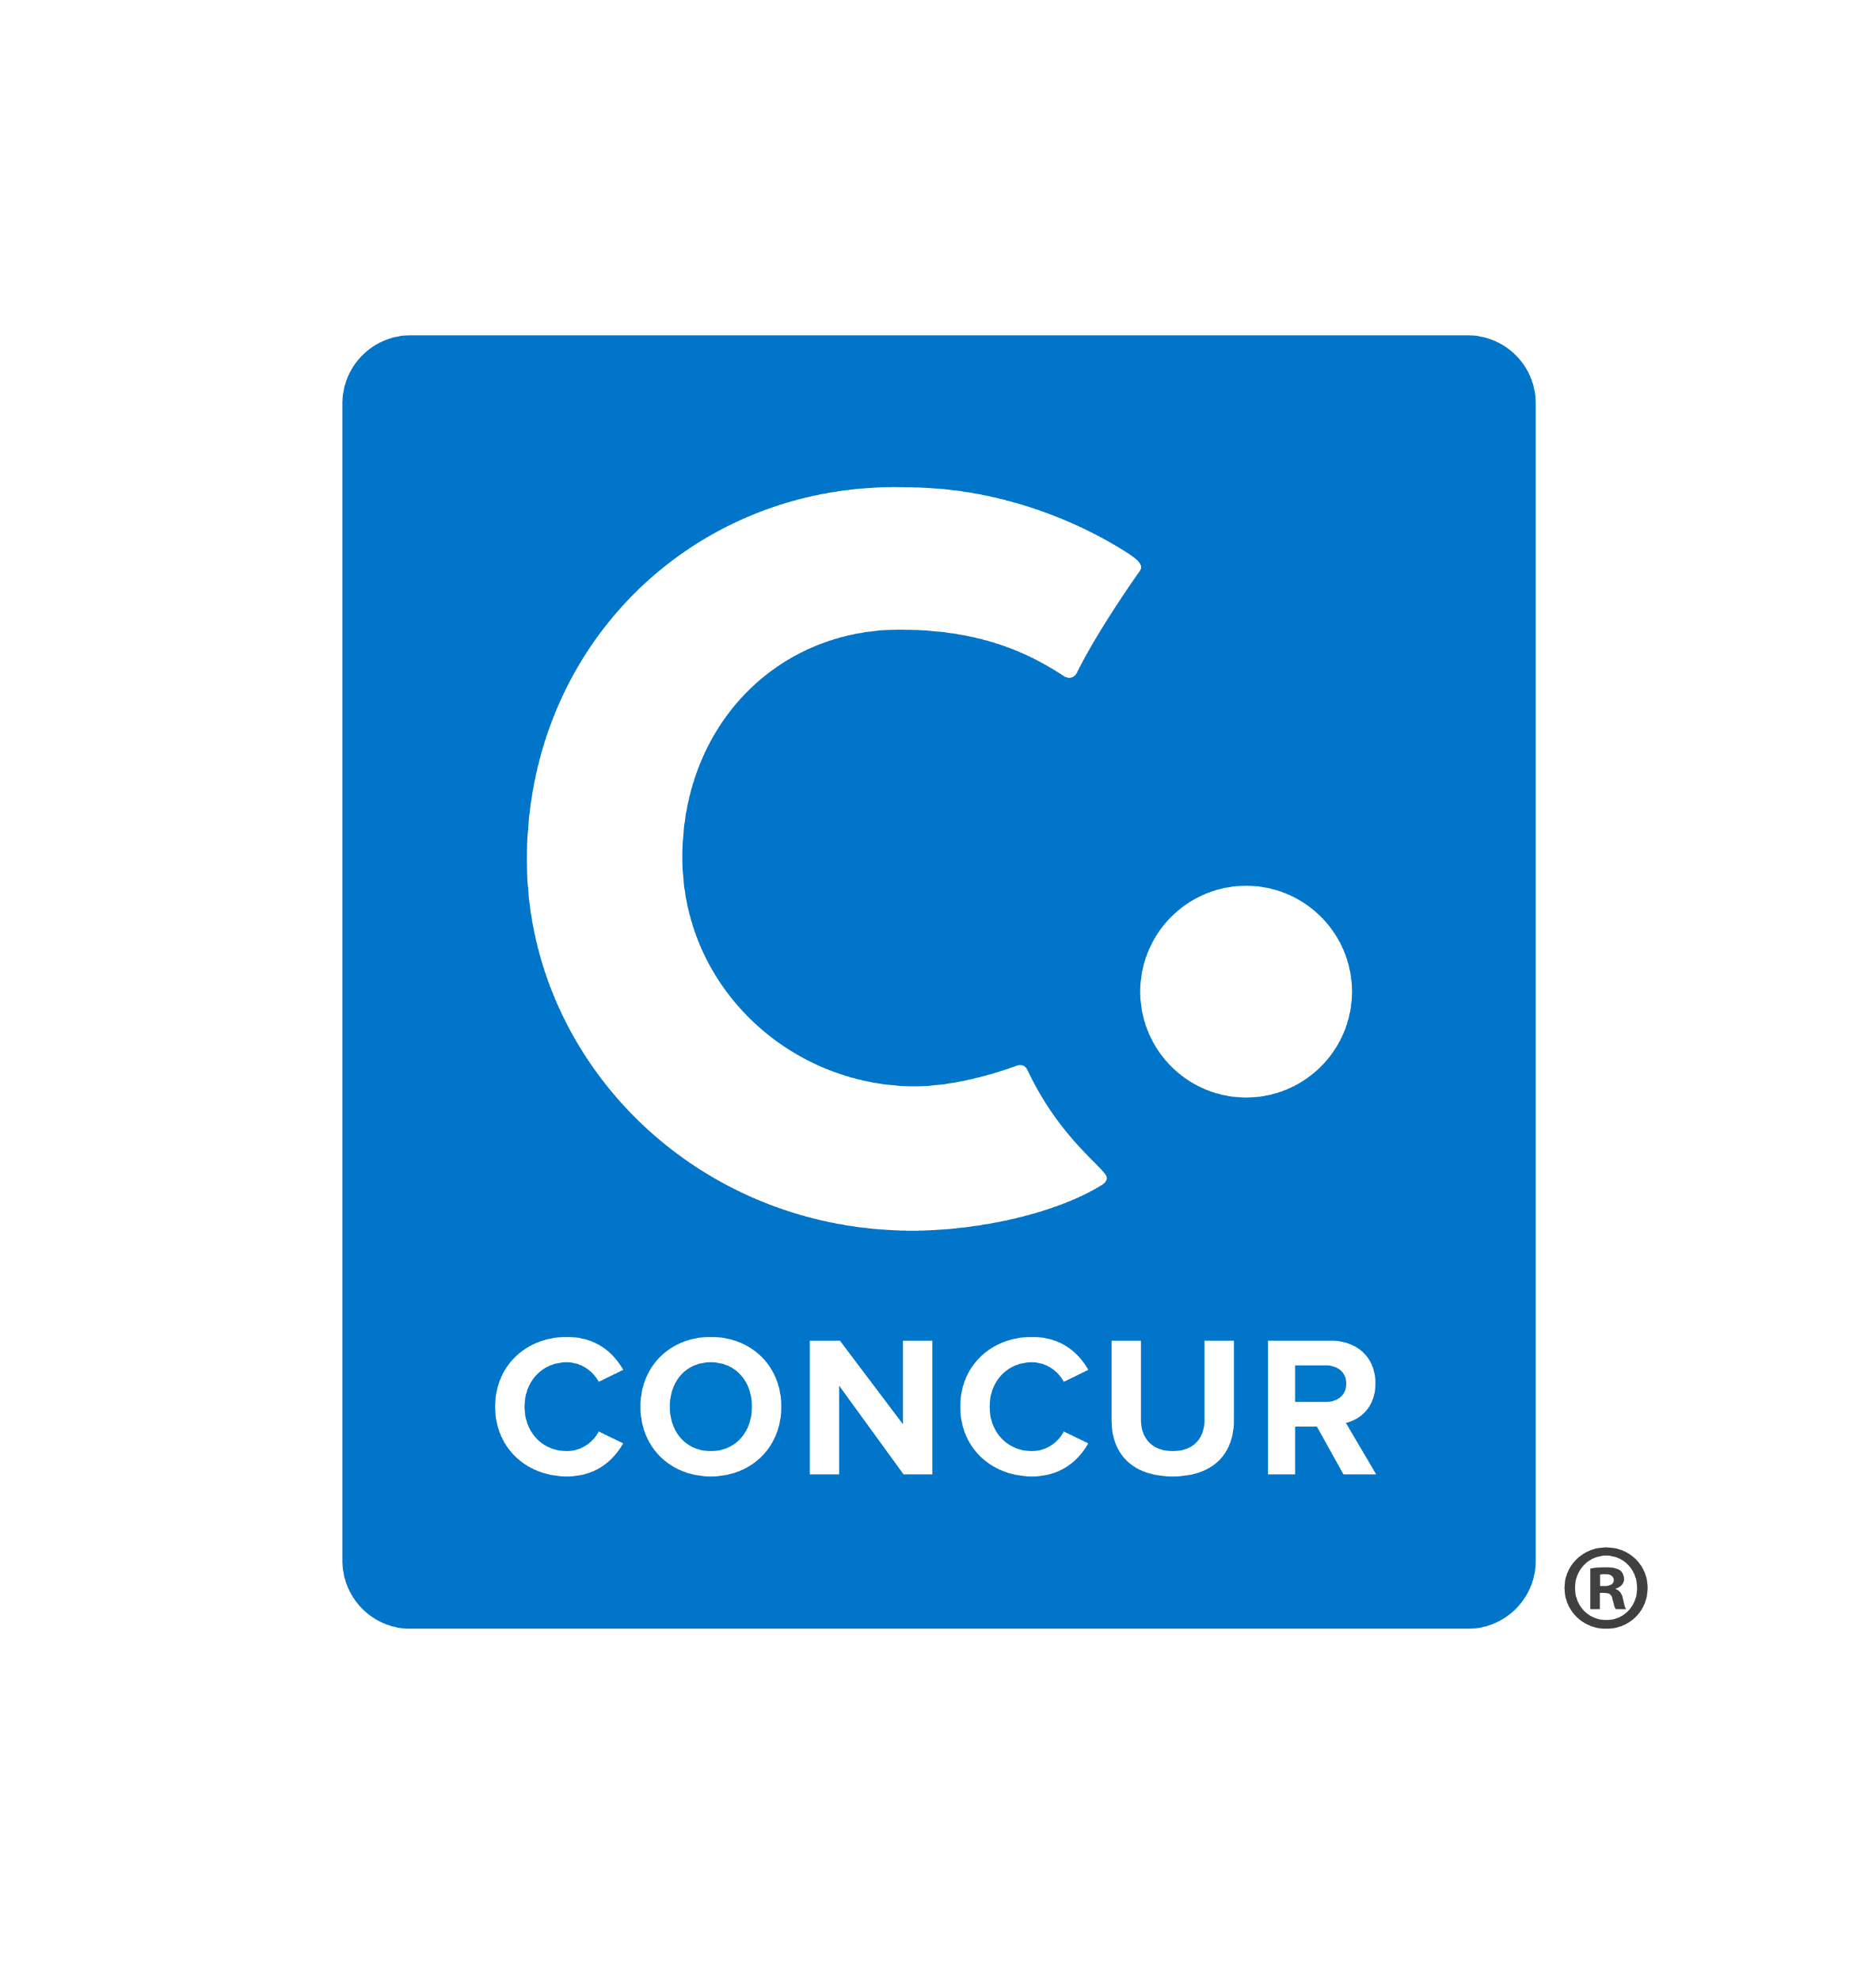


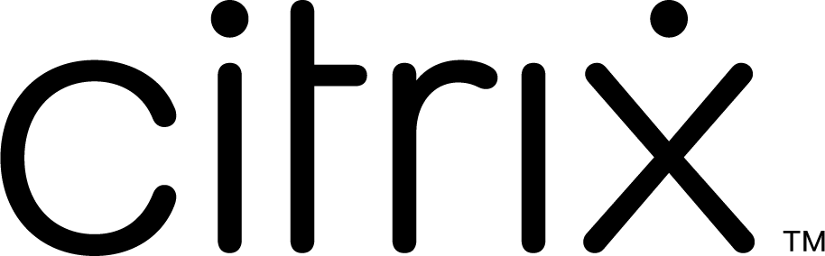
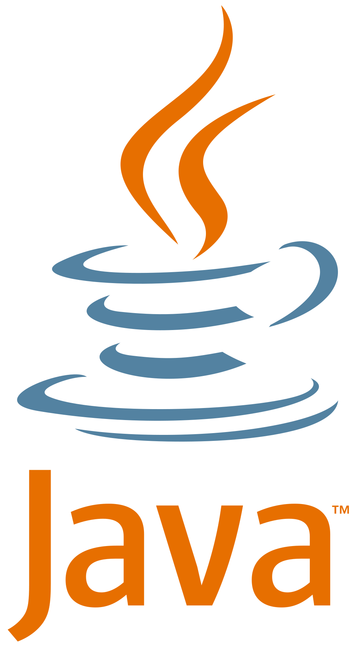
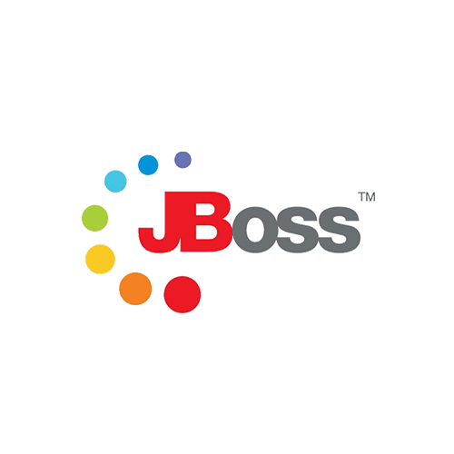
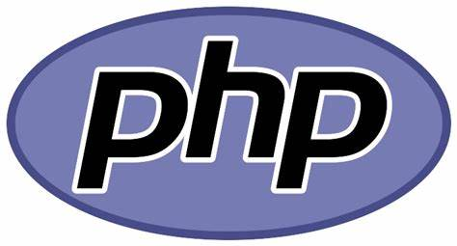
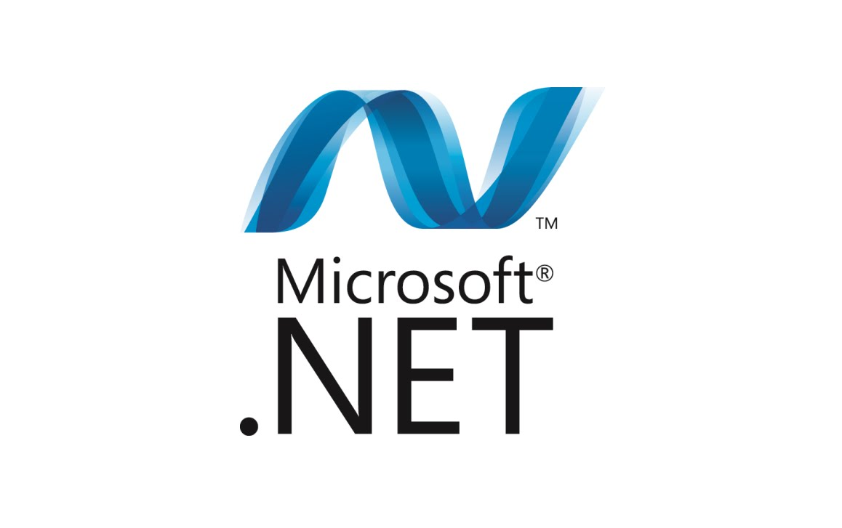
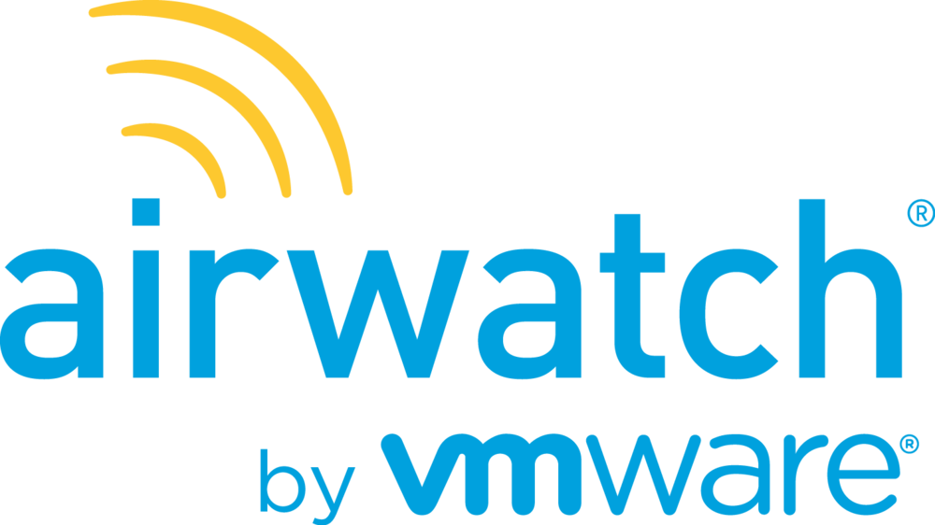


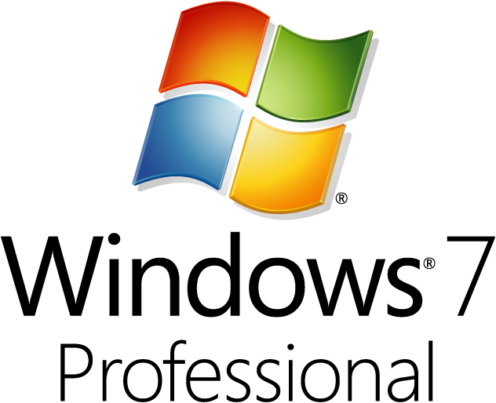
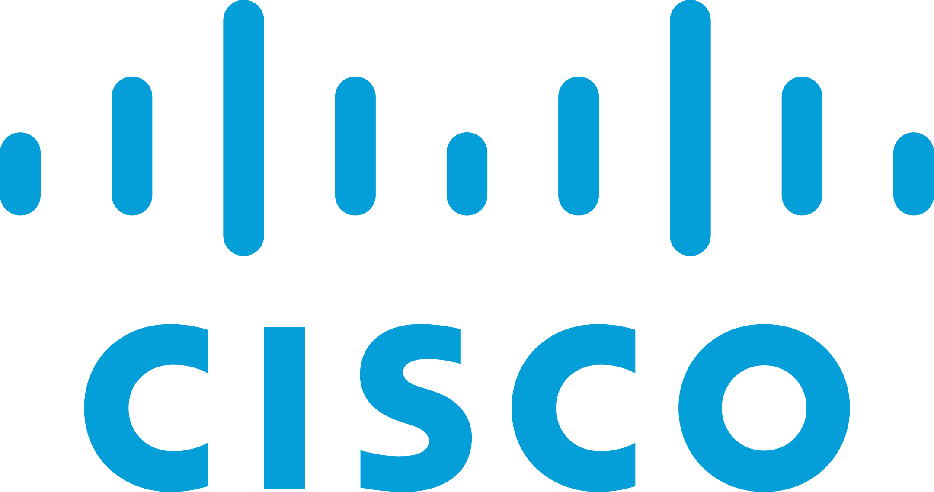



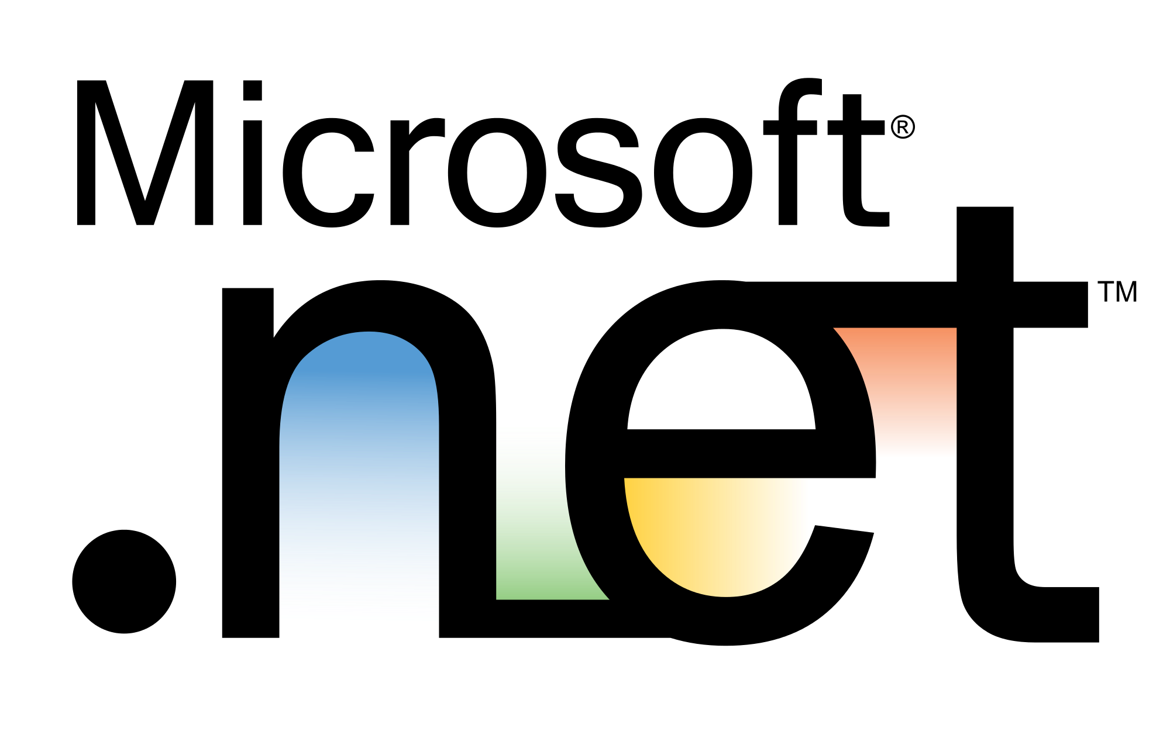
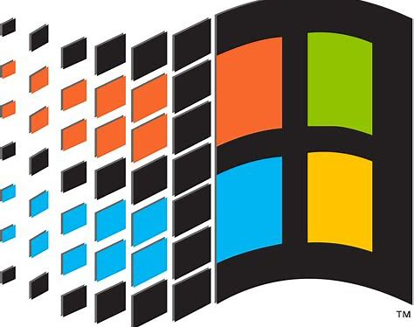


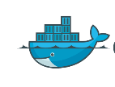
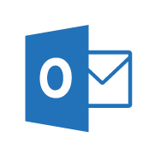
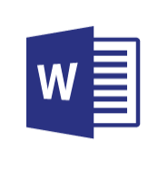
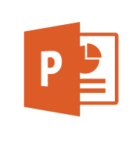
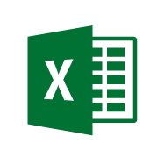
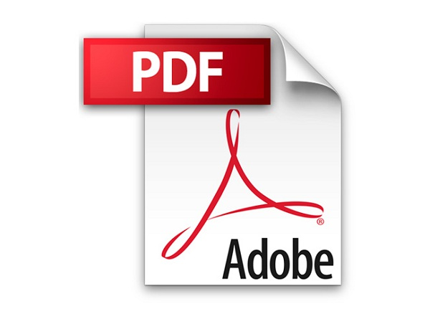

Zero Trust User Access
Legend
Full access
Limited access
Risk Mitigation
Remediation Path
December 2021 – https://aka.ms/MCRA
Conditional Access to Resources
Policy is evaluated when
Initial Access + Token Refresh
Change in security posture
Microsoft Applications
User Threat/ Risk Signals
Azure AD Identity Protection
Leaked cred protection
Behavioral Analytics
Lower Access
Restricted session
Office 365
Dynamics 365
Microsoft Defender for Identity
Cloud Infrastructure
Organization Policy
Azure Portal
User risk
Microsoft Defender for Cloud Apps
User/Session Risk
Linux Login
Conditional Access
Modern Applications
Hello for Business
Increase Trust by requesting MFA
Monitor & Restrict Access
Azure MFA
Multi-Factor Authentication
Microsoft Defender for Cloud Apps
Conditional Access App Control
SaaS Applications
3rd Party MFA
Security & Compliance Policy Engine
Microsoft Threat Intelligence 8+ Trillion signals per day of security context & Human Expertise
IsCompliant
Azure Active Directory (Azure AD)
Device Attribute(s)
Azure AD B2B & B2C
Azure AD App Proxy
Legacy Apps (Secure VPN Replacement )
Partner MDM
Microsoft Intune
3rd party VPN and Remote Access Devices
{LDAP}
Remediate Leaked Credential (Requires MFA)
Microsoft Information Protection (MIP)
Microsoft Defender for Endpoint
Device Threat/ Risk Signals
Documents
Device risk
Azure AD Self Service Password Reset (SSPR)
Microsoft Intune (MAM functionality)
Mobile Apps
Active Directory
IsManaged
Approved Apps
Signal to make an informed decision
Decision based on organizational policy
Enforcement of policy across resources
Notes:
Key Takeaway: User Access is often the first priority for Zero Trust because it rapidly brings productivity benefits and security coverage for key gaps
Enabling users to be productive anywhere and secure requires explicit validation of user and device risk/trustworthiness using high quality signals.
CLICK 1 – User Risk
Measuring user risk requires analyzing the risk of the account itself, the current access request session, and whether they are using MFA:
User/Session Risk - Azure Active Directory (Azure AD) Identity Protection analyzes the user account and current access request, providing a high/medium/low risk rating to Azure AD conditional access. This rating is determined by a machine learning calculation across numerous individual risk factors including leaked credentials, atypical travel, malicious IP address, malware-linked IP address, and suspicious inbox manipulation rules (provided by Microsoft Defender for Cloud Apps). For information on risk levels, see https://docs.microsoft.com/azure/active-directory/identity-protection/concept-identity-protection-risks
Multi-factor authentication (MFA) – MFA is required for reasonable security assurances because attackers can (easily) impersonate an account that is protected by password-only authentication through stolen or guessed passwords. Azure AD conditional access identifies if the user has been authenticated by MFA using Azure AD MFA, Hello for Business, or a 3rd party MFA provider (via ADFS)
CLICK 2 – Device Risk
Device risk is measured by explicitly verifying whether it is compliant with the organization’s policies, which can include verification that no malicious activity has been detected from the installed endpoint detection and response (EDR) capability.
IsCompliant – Microsoft Endpoint Management Intune provides management of device security policy that evaluates signals from Intune managed clients, Microsoft Defender for Endpoint, and partner MDMs.
Device Attribute – Conditional Access can filter policies so they require a specific device attribute (e.g. to identify highly secured privileged access workstations or PAWs) - https://docs.microsoft.com/azure/active-directory/conditional-access/concept-condition-filters-for-devices
CLICK 3 – Policy Evaluation and MFA
Azure AD Conditional Access evaluates these signals against the policy you have configured. This combination of static policies and dynamic real-time information (threat intelligence, session context, etc.) provides an adaptive approach to managing risk that is both consistent and informed by continuously changing real-world conditions.
Initial Access + Token Refresh – For all applications using conditional access, policy validation happens at the time of each access request + when the token is refreshed to extend the expiration time.
Change in security posture - Additionally, conditional access supports Continuous Access Evaluation (CAE) to provide faster responsiveness to changing risk conditions in near-realtime (e.g. network location change, user termination, or potential credential theft event). This is currently supported by a few key applications like Exchange Online, SharePoint Online, and Teams. For more information, see https://docs.microsoft.com/azure/active-directory/conditional-access/concept-continuous-access-evaluation
CLICK 4 – Remediation of High Risks
If user/session risk is rated as high (indicating that the credentials are likely/known to be compromised), you can configure the user to be automatically redirected to self-service password reset (SSPR) site to immediately change their password.
For more information, see https://docs.microsoft.com/azure/active-directory/authentication/tutorial-risk-based-sspr-mfa
CLICK 5 – First Integrations (Microsoft Applications and 3rd party VPN and Network Devices)
After explicitly validating that the user/session and device risk is low enough, access is granted access to the resource.
The first integrations are usually:
Microsoft Applications, as these cloud applications natively support Azure AD and Conditional Access.
3rd Party VPN and Remote Access Devices - to rapidly increase security for remote access of your applications and network for remote and hybrid work senarios. This quickly adds sophisticated user and device risk validation authentication which mitigates common password and device risks. Many vendors support Azure AD authentication including Cisco AnyConnect, Palo Alto Networks GlobalProtect and Captive Portal, F5, Fortinet FortiGate SSL VPN, Citrix NetScaler, Zscaler Private Access (ZPA), Azure VPN AAD, and more. For more information on these, see https://docs.microsoft.com/azure/active-directory/saas-apps/tutorial-list
CLICK 6 – Enable your Enterprise Estate
Next, we expand to your full estate of enterprise applications across cloud, mobile, and on-premises applications
CLICK 7 – Legacy Applications and Session Monitoring
Azure AD App Proxy provides the ability to publish legacy on-premises applications to take advantage of these strong assurances (and also simplify user experience) that can help you move Beyond VPN
Microsoft Defender for Cloud Apps (Conditional Access App Control) also enables Session Monitoring and Restrictions. You can monitor sessions and restrict functionality with session policies based on signals from conditional access and other MDCA detections within the session including:
Prevent data exfiltration
Protect on download
Prevent upload of unlabeled files
Monitor user sessions for compliance
Block access
Block custom activities
For more information on MDCA CAAC, see https://docs.microsoft.com/cloud-app-security/proxy-intro-aad
Additional Information
Lower Access – You can restrict access to aspects of the application or data in it using native application features like this SharePoint site restriction on downloading, printing, or syncing files - https://docs.microsoft.com/sharepoint/control-access-from-unmanaged-devices

Slide 16






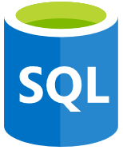
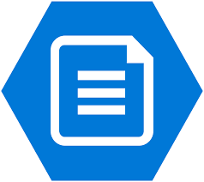
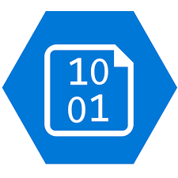
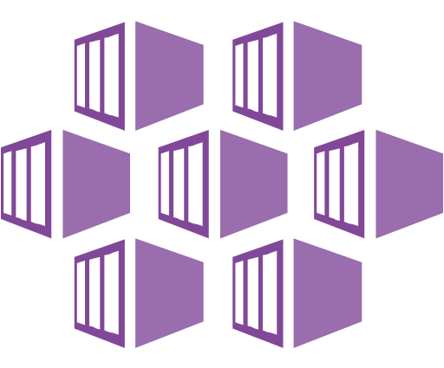
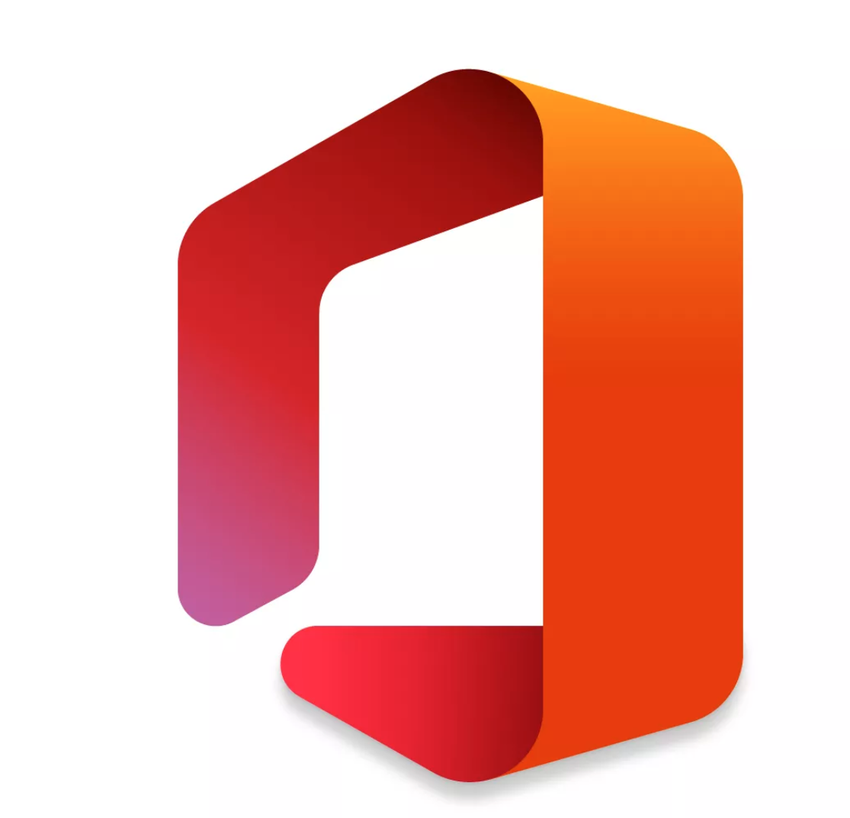

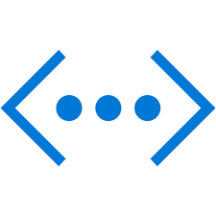
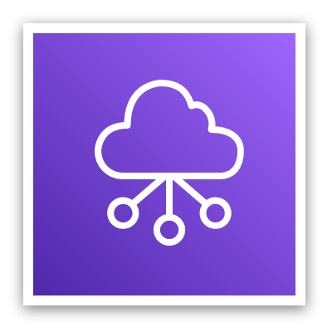

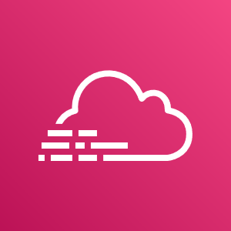
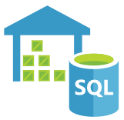
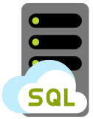


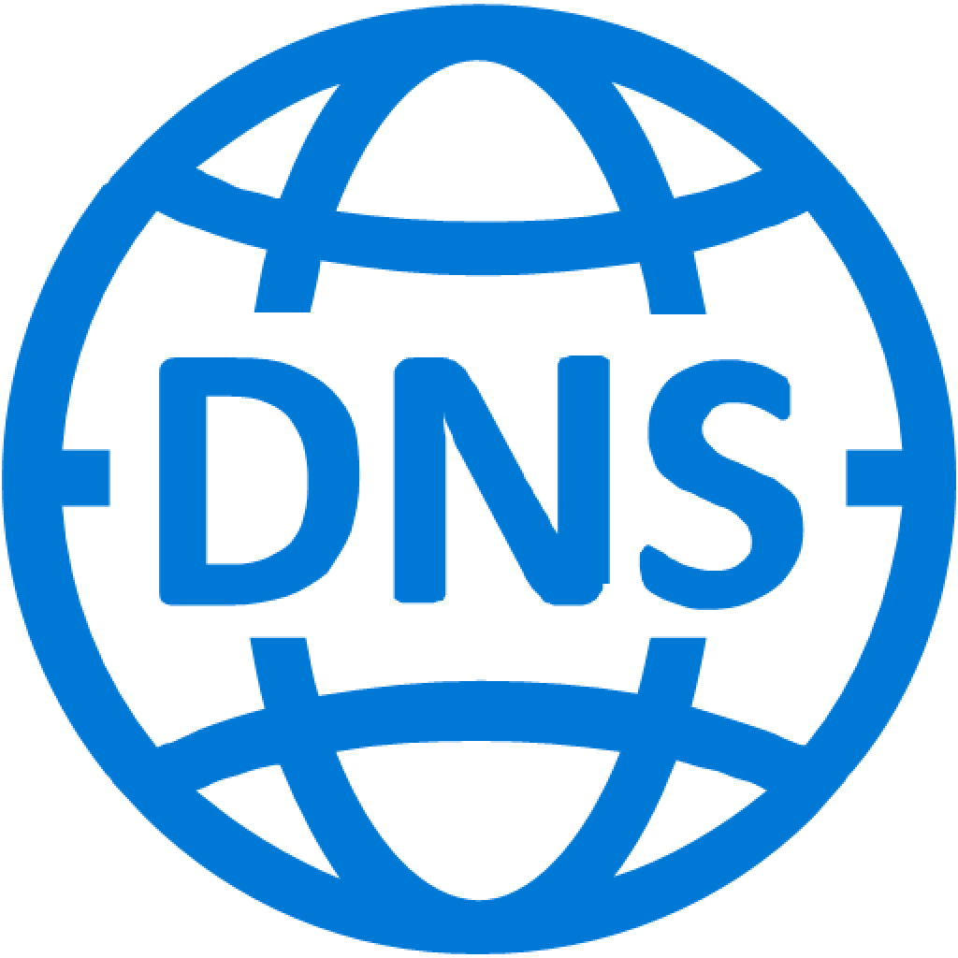

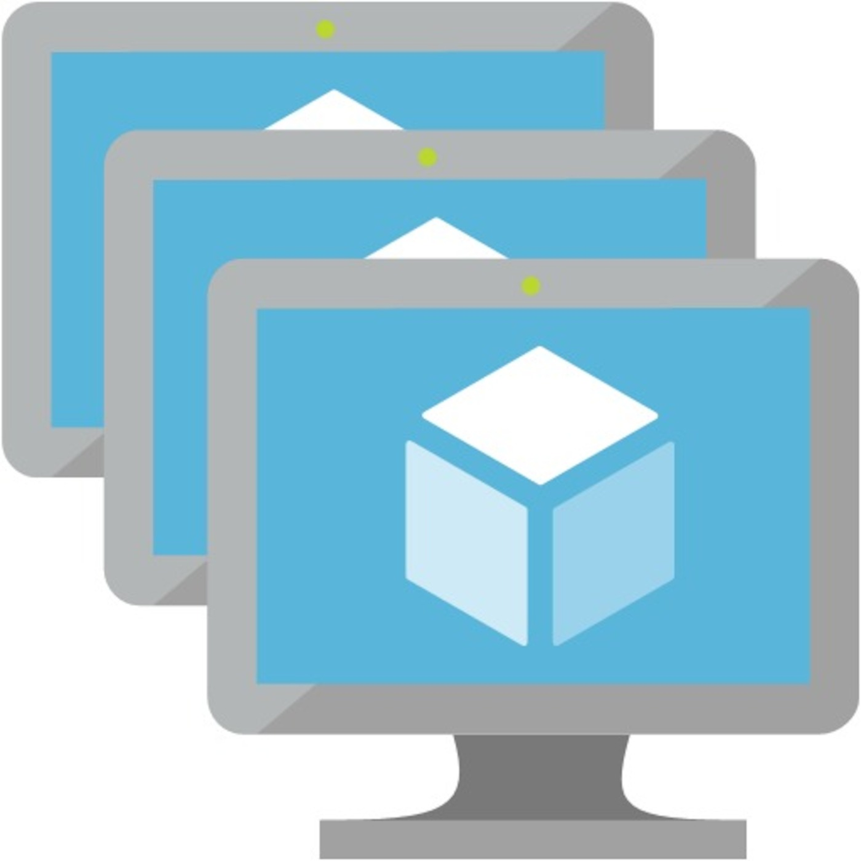

Traditional networking model based on physical geographic location
Public and Private Cloud– IaaS, PaaS, On-Premises
Software as a Service (SaaS)
Security Stack
VPN
WAN
Remote & Mobile Workers
The Office
Branch Office / Remote Operations
Notes:
Key Takeaway: Traditional Network approaches focused first on the physical location
Classic network security approaches started by focusing on a ‘trusted network’ model centered around with the physical office (and network) locations of the organization.
The main Office network was extended to remote locations through a combination of
Wide Area Networks (WANs) – for branch offices with multiple employees
Virtual Private Networks (VPNs) – to extend the network to individual remote devices and users

Slide 17


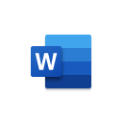
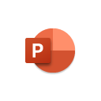




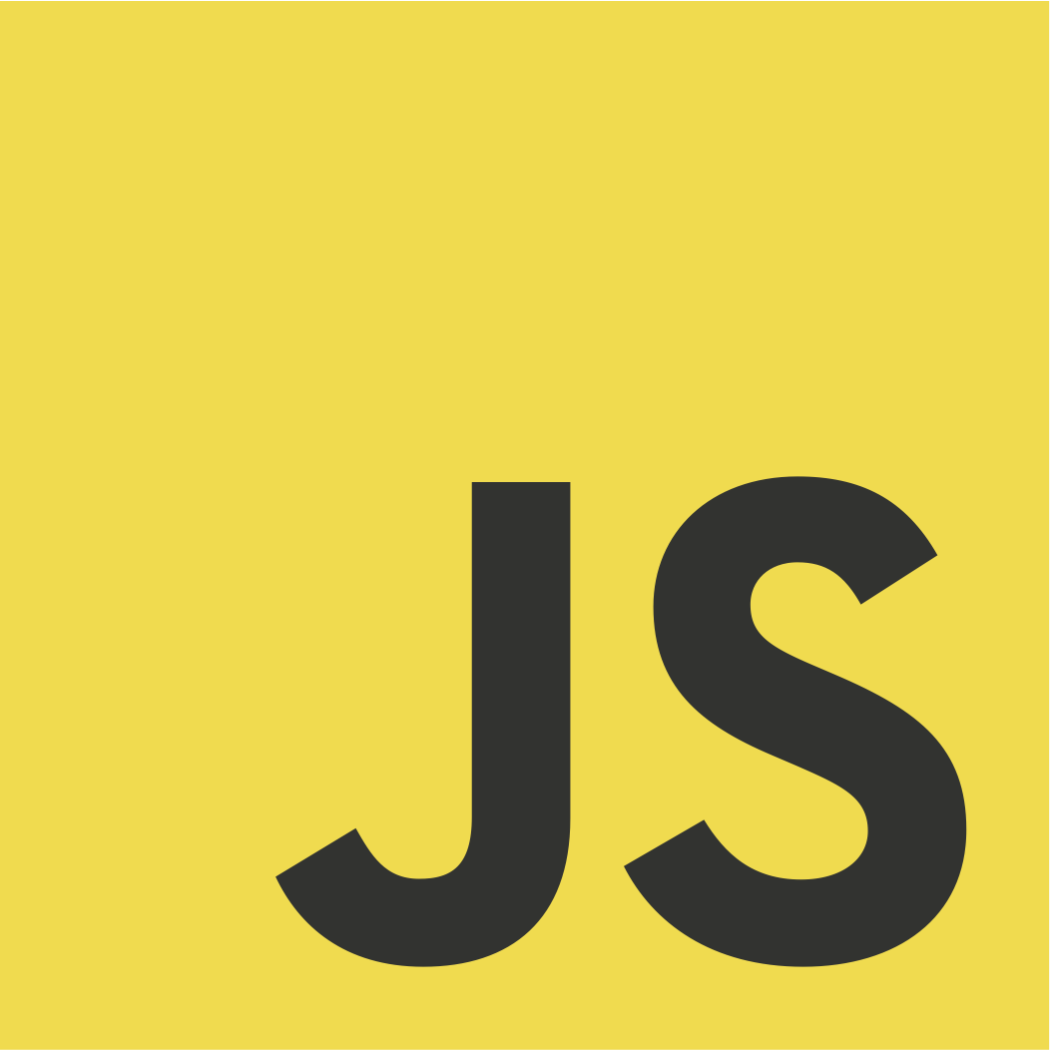

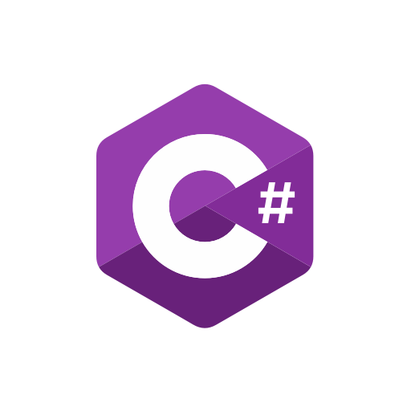
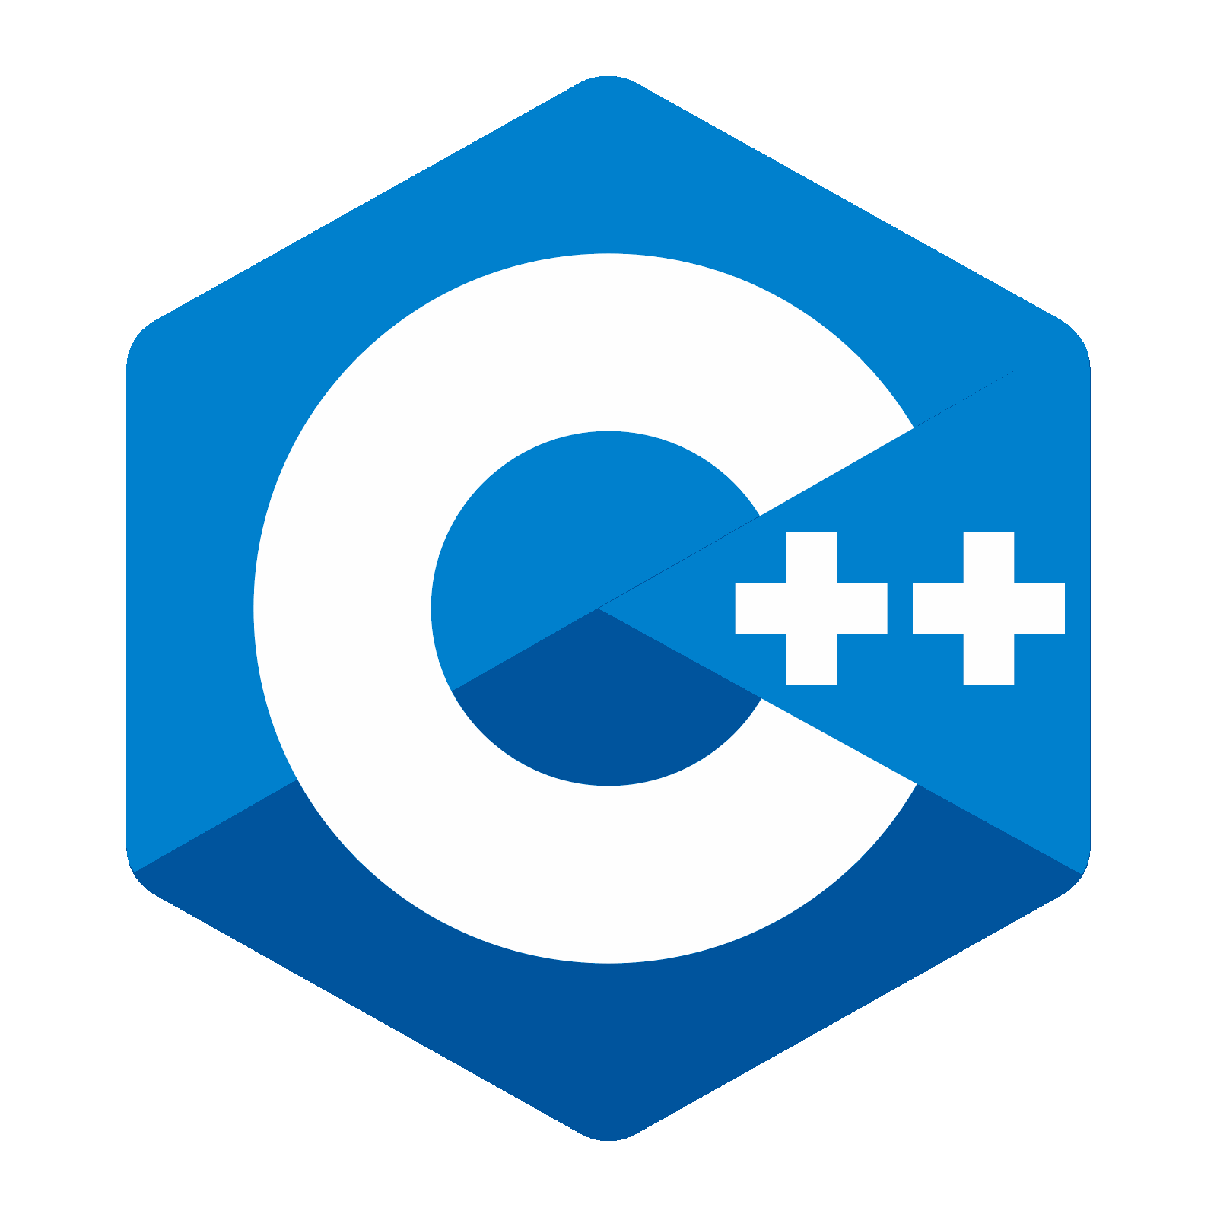









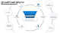
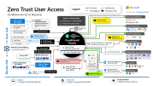
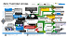

Secure Access Service Edge (SASE) Architecture for Secure, Responsive, and Pervasive Productivity
S3
Software as a Service (SaaS)
Public and Private Cloud– IaaS, PaaS, On-Premises
Sanctioned
Unsanctioned
Outcomes
Key Enablers
Policy Evaluation + Enforcement Points
Microsoft Capabilities
Partner Capabilities
Security - Resilient, Simple, Adaptable
Cloud Access Security Broker (CASB)
Defender for Cloud Apps
Access should follow zero trust principles
Explicit verification
Least privilege
Assume breach
Explicitly Measure User & Device Security
Access Policy
Zero Trust Network Access (ZTNA)
Private App/Network Access
Azure AD App Proxy
Azure VPN
Global Scale & Availability
Microsoft Tunnel
Secure Web Gateway (SWG)
Defender for Endpoint
Unmanaged Devices
Firewall as a Service (FWaaS)
Azure Firewall
Enable easy productivity anywhere
Responsive and seamless connections
Applications anywhere you need
Threat Intelligence
Software Defined WAN (SD-WAN)
Azure Virtual WAN
On-Prem & multi-cloud
User Experience - Slow is the new broken
Identity as a Service
Web Application Firewall (WAF)
Azure WAF
Content Delivery Network (CDN)
Azure CDN
DNS Protection
Defender for DNS
Other DNS Services/Servers
Azure Active Directory – Passwordless, MFA, Leaked Credential Protections, Behavioral Analytics, PIM, Identity Governance, & more
BYOD and Partner Devices/Users
Managed Users and Devices
The Office
IoT and OT Environment
Notes:
Key Takeaway: SASE is a flexible security approach that focuses on enabling secure access to resources from anywhere
Like Zero Trust, the Secure Access Service Edge (SASE) approach recognizes the business imperative to enable people to securely work anywhere and access to any resource they need (across multiple clouds and on-premises)
CLICK 1 – Outcomes and Enablers
The key outcomes of a SASE approach of a good user experience and strong security assurances
User Experience - SASE recognizes that user experience and performance are critical in this new world where users believe that “slow is the new broken” .
Security - SASE also follows the same principles of zero trust, where security must design strategies with an assumption of breach (anything could be compromised), trust must be verified explicitly, and provide least privileged using Just-in-Time and Just-Enough-access using risk-based adaptive polices.
To provide these, the SASE approach requires key enablers including:
Global Scale and availability – to ensure that authorize applications are responsive and perform well for users
Explicit measurement User and Device security assurances:
Identities - strong authentication, account isn’t compromised, etc.
Device – compliant configuration, not infected by malware, etc.
Threat intelligence – to inform these security decisions with up to date context (drawn from a dataset that is both high volume and highly diverse). This helps quickly filter out known threats and accurately measure risk (avoiding false positives and false negatives that create business risk or interrupt productivity)
CLICK 2 – Policy Evaluation and Enforcement Points
Making SASE real requires using these enablers to make and enforce access decisions across the diverse set of devices and services that comprise the “edge” of your modern digital estate.
The organization’s Access Policy to considers these signals in the decide whether to grant, deny, monitor, or restrict access for resource access requests.
The policy enforcement points apply this access decision across the estate, ensuring that a consistent policy is applied across SaaS applications, cloud infrastructure, cloud platforms, and on-premises resources.
CLICK 3 – Microsoft capabilities
Microsoft recognizes that no single vendor today has all capabilities required for a full SASE solution. Microsoft is focused on ensuring you can have a complete SASE approach with a combination of native cloud capabilities and by working closely with our Microsoft Intelligent Security Association (MISA) partners.
You can implement a large percentage of SASE concepts today with Microsoft capabilities:
Identity as a Services – Azure Active Directory (Azure AD) provides Identity and Access control for all your cloud and on-premises resources, with integrated security that provides strong assurances for employees, partners (B2B), and customers/clients/citizens (B2C) across any platform or cloud including:
Passwordless and MFA – capabilities to simplify the user experience and strengthen security assurances via Hello For Business biometric authentication, Authenticator App (works on any modern mobile phone), and FIDO2 keys
Identity Protection – against highly prevalent attacks with Leaked Credential Protections, Behavioral Analytics, Threat Intelligence integration and more
Azure AD PIM reduces risk by providing just in time access to privileged accounts using approval workflows
Identity Governance helps ensure the right people have access to the right resources
Azure AD B2B and B2C provide security for partner and customer/client/citizen accounts while separating them from enterprise user directories
Cloud Access Security Broker (CASB) - Microsoft Defender for Cloud Apps (MDCA) provides Cloud Access Security Broker (CASB) capabilities that provide XDR for SaaS applications as well as governance, threat protection, data protection and more for these SaaS apps and the data stored on them. MDCA integrates with other capabilities in Microsoft’s portfolio to extend them to SaaS applications to simplify management and security.
Zero Trust Network Access (ZTNA) – provides Private App/Network Access for devices coming from public networks.
Azure AD App Proxy extends the modern access control approach (security perimeter) to on-premises resources by simplifying user access to them and modernizing security with Conditional Access (which explicitly validates user and device trust, a Zero Trust principle).
Azure VPN provides site-to-site and point-to-site VPN access for your resources that aren’t yet provided through Azure AD App Proxy. Azure AD also provides enhanced security assurances for both Azure AD and any existing VPNs you may have.
Microsoft Tunnel for Microsoft Intune provides a VPN capability tailored to the mobile device experience.
Secure Web Gateway (SWG) – Microsoft Defender for Endpoint (MDE) provides Web Content Filtering for managed devices as part of endpoint security capabilities. Microsoft also works with our MISA partners that provide a full SWG capability for both managed and unmanaged devices using network traffic interception.
Firewall as a Service – Azure Firewall provides a managed, cloud-based network security service that helps protect resources accessed via Azure networks (including TLS Inspection, IDPS, URL Filtering, and Web Categories). Microsoft integrates with partners that provide this capability for resources accessed via on premises and on 3rd party cloud networks.
Web Application Firewall (WAF) - Azure WAF provides centralized protection of your web applications from common exploits and vulnerabilities accessed via Azure networks. Microsoft integrates with partners that provide this capability for resources accessed via on premises and 3rd party cloud networks.
Software Defined WAN (SD-WAN) - Azure Virtual WAN is a networking service that brings many networking, security, and routing functionalities together to provide a single operational interface. This is available in Azure regions around the globe integrates with many partner offerings.
Content Delivery Network - Azure Content Delivery Network (CDN) offers organizations a global solution for rapidly delivering high-bandwidth content to users by caching their content at strategically placed physical nodes across the world.
DNS Protection - Microsoft Defender for DNS provides protection for resources that use the Azure DNS’s name resolution capability. Partner solutions can provide additional protection for other name resolution capabilities.

Slide 18






Identity is the control plane
Secure access for a connected world
Notes:
Talk track:
In this world your identity system in the cloud is your control plane that can connect everything, give you visibility to your entire digital estate, ensure that only right people have the right access to the right resources, and keep the bad players out. Microsoft’s Azure Active Directory is a universal identity platform that helps you manage and secure all of your users and access to all your apps.
You are leading digital transformation to help your companies get ready for the opportunities in the cloud era and reinvent the way we work.

Slide 19
Secure your organization with Zero Trust
A modern security framework with identity as its foundation
Verify explicitly | Use least-privileged access | Assume breach
Data
Zero Trust policy
Identities
Apps
Infrastructure
Context Control
Endpoints
Network
Visibility | Analytics | Automation
Notes:
Talk track:
At Microsoft, we build our security solutions upon a key set of principles.
Move from assumption to explicit verification.
Adopt a policy-based, least privileged access model.
Design with the assumption that every element of your system can be breached.
These are the key principles of Zero Trust. Zero Trust provides a modern security framework to manage the complexity of today's organization. A holistic approach to Zero Trust should extend throughout the entire digital estate—it serves as an integrated security philosophy and an end-to-end strategy. You can do this by implementing Zero Trust controls and technologies across six foundational elements.
Identities: Identities, whether they represent people, services, or IOT devices define the Zero Trust control plane. When an identity attempts to access a resource, we need to verify that identity with strong authentication, ensure access is compliant and typical for that identity, and follows least privilege access principles.
Devices: Once an identity has been granted access to a resource, data can flow to a variety of different devices—from IoT devices to smartphones, BYOD to partner managed devices, and on-premises workloads to cloud-hosted servers. This diversity creates a massive attack surface area, requiring we monitor and enforce device health and compliance for secure access.
Data: Ultimately, security teams are focused on protecting data. Where possible, data should remain safe even if it leaves the devices, apps, infrastructure, and networks the organization controls. Data should be classified, labeled, and encrypted, and access restricted based on those attributes.
Applications: Applications and APIs provide the interface by which data is consumed. They may be legacy on-premises, lift and shifted to cloud workloads, or modern SaaS applications. Controls and technologies should be applied to discover shadow IT, ensure appropriate in-app permissions, gate access based on real-time analytics, monitor for abnormal behavior, control user actions, and validate secure configuration options.
Infrastructure: Infrastructure (whether on-premises servers, cloud-based VMs, containers, or microservices) represents a critical threat vector. Assess for version, configuration, and JIT access to harden defense, use telemetry to detect attacks and anomalies, and automatically block and flag risky behavior and take protective actions.
Networks: All data is ultimately accessed over network infrastructure. Networking controls can provide critical “in pipe” controls to enhance visibility and help prevent attackers from moving laterally across the network. Networks should be segmented (including deeper in network micro segmentation) and real time threat protection, end to end encryption, monitoring, and analytics should be employed.
Then, use key tools to tie it together:
Policy driven access: Modern micro-segmentation means more than networks. It requires we also gate access based on role, location, behavior patterns, data sensitivity, client application, and device security. It’s important to ensure all policy is automatically enforced at the time of access and continuously throughout the session where possible.
Visibility, Analytics, and Automation: Telemetry from the systems above must be processed and acted on automatically. Attacks happen at cloud speed – your defense systems must act at cloud speed as well, and humans just can’t react quickly enough. Integrate intelligence with policy-based response for real-time automated threat protection.
Because we believe organizations need to embrace Zero Trust, we’ve built it into the heart of our products and services. Our integrated solutions offer built-in Zero Trust controls so you can implement your security model at scale across the entire digital state. Now let’s explore how Microsoft security technology can help your organization.

Slide 20

Networking Considerations
1. Network isolation between Switzerland and global environment
2. No public endpoints (except app access if needed)
VMs with private IP
PaaS with private endpoints and/or VNet Injection
3. How customers will access applications?
Azure Virtual Desktop + GPS-based Conditional Access
Private Connectivity w/ Application Gateway + Location Based Conditional Access
Public Endpoints on a DMZ w/ Application Gateway + Location Based Conditional Access
Use Express Route with E2E encryption
Express Route Direct w/ MacSec + IPSec tunnel
Express Route w/ IPSec tunnel
Notes:
Identity and Access Management in Enterprise-scale addresses Azure control plane, data plane, and application layer requirements.
Planning for Identity and Access Management begins with the Azure platform and Azure Active Directory. Many consider identity to be the primary perimeter for security. This is a shift from the traditional focus on network security. Network perimeters keep getting more porous, and that perimeter defense can’t be as effective as it was before the explosion of BYOD devices and cloud applications. Enterprise-scale recommendations focus on defining least privileged Role Based Access Control roles aligned to the customer’s operating model and leveraging Azure capabilities to apply additional layers of access control.
Use Azure AD Privileged Identity Management to establish zero standing access and to enable approval workflows for just-in-time control plane access to azure resources. Granting entitlements through PIM, rather than direct resource access, helps to protect against legacy access rights that often result from changing roles and responsibilities within an organization.
Use Azure AD PIM access reviews to periodically validate resource entitlements. Regularly scheduled reviews of access rights and entitlement use is a regulatory requirement for many customers. Determining which users had access to what resources for a given time period is much easier with PIM compared to querying AAD audit logs.
Customer RBAC roles should be used to define access rights across the Azure estate. Key roles within an organization will typically include Platform Owners, NetOps, SecOps, AppOps, and DevOps. Well defined and scoped RBAC role definitions enable subscription democratization through the segregation of duties required by an organization’s operating model.
Integrate Azure AD logs with the platform-central Azure Monitor Log Analytics workspace for audit reports and alert notifications.
Use Azure AD Managed Identities (MI) for Azure resources, avoiding username and password-based authentication. Managed Identities provide the simples and most secure method for enabling service to service communication. Managed Identities eliminate the need for credentials in your code, they rotate credentials automatically, and can be used to authenticate to any service that supports Azure AD authentication.
Multi-Factor Authentication should be enforced on all privileged accounts. If you only use a password to authenticate a user, it leaves an insecure vector for attack. If the password is weak or has been exposed elsewhere, is it really the user signing in with the username and password, or is it an attacker? When you require a second form of authentication, security is increased as this additional factor isn't something that's easy for an attacker to obtain or duplicate.
Conditional Access policies should be enforced on all privileged accounts. Azure Active Directory (Azure AD) Conditional Access (CA) analyses signals such as user, device, and location to automate decisions and enforce organizational access policies for resource. You can use CA policies to apply access controls like Multi-Factor Authentication (MFA). CA policies allow you to prompt users for MFA when needed for security and stay out of users’ way when not needed.
Planning for Authentication Inside the Landing Zone is concerned with workload access and dependencies on on-premises systems. A critical design decision enterprise organization must make when adopting Azure is whether to extend and existing on-premises identity domain into Azure or create a brand new one. Requirements for authentication inside the "Landing Zone" should therefore be thoroughly assessed and incorporated into plans to deploy AD, Azure AD-DS or both.
Examples:
Use AAD RBAC to manage data plane access to resources where possible (e.g. Key Vault, Storage Account, Azure SQL DB). Use Managed Identities instead of Service Principles for authentication to Azure services.
Evaluate the compatibility of workloads for AD and AAD-DS. Do not assume existing workloads are agnostic of AD and AAD-DS authentication, as there are differences between both approaches.
Deploy AAD-DS within the primary region as this service can be projected into only one subscription. Use Virtual Network Peering to support its usage as an authentication service.
Use Just-In-Time access for both VM access and Azure control plane administration.
Knowledge Check
Where should Azure Control Plane Groups live?
a.) On-Premise AD – The group will not be able to
b.) On-premise AD synced to Azure AD
c.) Azure AD only – You are managing your control plane on Azure only, so having this group on premise creates overhead with no functional benefit. Always create groups in Azure AD if they don’t manage anything on premise.
How should resource to resource authentication occur?
a.) By using Managed Services Identities - The feature provides Azure services with an automatically managed identity in Azure AD. You can use the identity to authenticate to any service that supports Azure AD authentication, including Key Vault, without any credentials in your code.
b.) By using Password Based Authentication – this is a static method and not best practice as securely storing these credentials creates management overhead
c.) Use Azure Key Vault – key vault provides storage to your keys and secrets but it’s not responsible for initiating authentication

Slide 21

Identity and Access Management
1. Use always Conditional Access with MFA and GPS-based named locations
2. Use the principle of least privilege
Together with:
Azure AD Privileged Identity Management
Azure AD Identity Protection
Azure AD Access Reviews
Notes:
Identity and Access Management in Enterprise-scale addresses Azure control plane, data plane, and application layer requirements.
Planning for Identity and Access Management begins with the Azure platform and Azure Active Directory. Many consider identity to be the primary perimeter for security. This is a shift from the traditional focus on network security. Network perimeters keep getting more porous, and that perimeter defense can’t be as effective as it was before the explosion of BYOD devices and cloud applications. Enterprise-scale recommendations focus on defining least privileged Role Based Access Control roles aligned to the customer’s operating model and leveraging Azure capabilities to apply additional layers of access control.
Use Azure AD Privileged Identity Management to establish zero standing access and to enable approval workflows for just-in-time control plane access to azure resources. Granting entitlements through PIM, rather than direct resource access, helps to protect against legacy access rights that often result from changing roles and responsibilities within an organization.
Use Azure AD PIM access reviews to periodically validate resource entitlements. Regularly scheduled reviews of access rights and entitlement use is a regulatory requirement for many customers. Determining which users had access to what resources for a given time period is much easier with PIM compared to querying AAD audit logs.
Customer RBAC roles should be used to define access rights across the Azure estate. Key roles within an organization will typically include Platform Owners, NetOps, SecOps, AppOps, and DevOps. Well defined and scoped RBAC role definitions enable subscription democratization through the segregation of duties required by an organization’s operating model.
Integrate Azure AD logs with the platform-central Azure Monitor Log Analytics workspace for audit reports and alert notifications.
Use Azure AD Managed Identities (MI) for Azure resources, avoiding username and password-based authentication. Managed Identities provide the simples and most secure method for enabling service to service communication. Managed Identities eliminate the need for credentials in your code, they rotate credentials automatically, and can be used to authenticate to any service that supports Azure AD authentication.
Multi-Factor Authentication should be enforced on all privileged accounts. If you only use a password to authenticate a user, it leaves an insecure vector for attack. If the password is weak or has been exposed elsewhere, is it really the user signing in with the username and password, or is it an attacker? When you require a second form of authentication, security is increased as this additional factor isn't something that's easy for an attacker to obtain or duplicate.
Conditional Access policies should be enforced on all privileged accounts. Azure Active Directory (Azure AD) Conditional Access (CA) analyses signals such as user, device, and location to automate decisions and enforce organizational access policies for resource. You can use CA policies to apply access controls like Multi-Factor Authentication (MFA). CA policies allow you to prompt users for MFA when needed for security and stay out of users’ way when not needed.
Planning for Authentication Inside the Landing Zone is concerned with workload access and dependencies on on-premises systems. A critical design decision enterprise organization must make when adopting Azure is whether to extend and existing on-premises identity domain into Azure or create a brand new one. Requirements for authentication inside the "Landing Zone" should therefore be thoroughly assessed and incorporated into plans to deploy AD, Azure AD-DS or both.
Examples:
Use AAD RBAC to manage data plane access to resources where possible (e.g. Key Vault, Storage Account, Azure SQL DB). Use Managed Identities instead of Service Principles for authentication to Azure services.
Evaluate the compatibility of workloads for AD and AAD-DS. Do not assume existing workloads are agnostic of AD and AAD-DS authentication, as there are differences between both approaches.
Deploy AAD-DS within the primary region as this service can be projected into only one subscription. Use Virtual Network Peering to support its usage as an authentication service.
Use Just-In-Time access for both VM access and Azure control plane administration.
Knowledge Check
Where should Azure Control Plane Groups live?
a.) On-Premise AD – The group will not be able to
b.) On-premise AD synced to Azure AD
c.) Azure AD only – You are managing your control plane on Azure only, so having this group on premise creates overhead with no functional benefit. Always create groups in Azure AD if they don’t manage anything on premise.
How should resource to resource authentication occur?
a.) By using Managed Services Identities - The feature provides Azure services with an automatically managed identity in Azure AD. You can use the identity to authenticate to any service that supports Azure AD authentication, including Key Vault, without any credentials in your code.
b.) By using Password Based Authentication – this is a static method and not best practice as securely storing these credentials creates management overhead
c.) Use Azure Key Vault – key vault provides storage to your keys and secrets but it’s not responsible for initiating authentication

Slide 22

Security, Governance and Compliance
1. Set up “guard rails” with Azure Policy
2. Use Log Analytics and Azure Sentinel for log analysis and incident management
3. Use Defender for Cloud for security posture management and threat protection
4. Encryption at transit:
On-prem to Azure: Express Route MACSec and/or IPSec
5. Encryption at rest:
Use Customer Managed Keys (CMK) to encrypt data at rest with your own keys
Store keys in Azure Key Vault in HSM (Premium SKU)
Notes:
Identity and Access Management in Enterprise-scale addresses Azure control plane, data plane, and application layer requirements.
Planning for Identity and Access Management begins with the Azure platform and Azure Active Directory. Many consider identity to be the primary perimeter for security. This is a shift from the traditional focus on network security. Network perimeters keep getting more porous, and that perimeter defense can’t be as effective as it was before the explosion of BYOD devices and cloud applications. Enterprise-scale recommendations focus on defining least privileged Role Based Access Control roles aligned to the customer’s operating model and leveraging Azure capabilities to apply additional layers of access control.
Use Azure AD Privileged Identity Management to establish zero standing access and to enable approval workflows for just-in-time control plane access to azure resources. Granting entitlements through PIM, rather than direct resource access, helps to protect against legacy access rights that often result from changing roles and responsibilities within an organization.
Use Azure AD PIM access reviews to periodically validate resource entitlements. Regularly scheduled reviews of access rights and entitlement use is a regulatory requirement for many customers. Determining which users had access to what resources for a given time period is much easier with PIM compared to querying AAD audit logs.
Customer RBAC roles should be used to define access rights across the Azure estate. Key roles within an organization will typically include Platform Owners, NetOps, SecOps, AppOps, and DevOps. Well defined and scoped RBAC role definitions enable subscription democratization through the segregation of duties required by an organization’s operating model.
Integrate Azure AD logs with the platform-central Azure Monitor Log Analytics workspace for audit reports and alert notifications.
Use Azure AD Managed Identities (MI) for Azure resources, avoiding username and password-based authentication. Managed Identities provide the simples and most secure method for enabling service to service communication. Managed Identities eliminate the need for credentials in your code, they rotate credentials automatically, and can be used to authenticate to any service that supports Azure AD authentication.
Multi-Factor Authentication should be enforced on all privileged accounts. If you only use a password to authenticate a user, it leaves an insecure vector for attack. If the password is weak or has been exposed elsewhere, is it really the user signing in with the username and password, or is it an attacker? When you require a second form of authentication, security is increased as this additional factor isn't something that's easy for an attacker to obtain or duplicate.
Conditional Access policies should be enforced on all privileged accounts. Azure Active Directory (Azure AD) Conditional Access (CA) analyses signals such as user, device, and location to automate decisions and enforce organizational access policies for resource. You can use CA policies to apply access controls like Multi-Factor Authentication (MFA). CA policies allow you to prompt users for MFA when needed for security and stay out of users’ way when not needed.
Planning for Authentication Inside the Landing Zone is concerned with workload access and dependencies on on-premises systems. A critical design decision enterprise organization must make when adopting Azure is whether to extend and existing on-premises identity domain into Azure or create a brand new one. Requirements for authentication inside the "Landing Zone" should therefore be thoroughly assessed and incorporated into plans to deploy AD, Azure AD-DS or both.
Examples:
Use AAD RBAC to manage data plane access to resources where possible (e.g. Key Vault, Storage Account, Azure SQL DB). Use Managed Identities instead of Service Principles for authentication to Azure services.
Evaluate the compatibility of workloads for AD and AAD-DS. Do not assume existing workloads are agnostic of AD and AAD-DS authentication, as there are differences between both approaches.
Deploy AAD-DS within the primary region as this service can be projected into only one subscription. Use Virtual Network Peering to support its usage as an authentication service.
Use Just-In-Time access for both VM access and Azure control plane administration.
Knowledge Check
Where should Azure Control Plane Groups live?
a.) On-Premise AD – The group will not be able to
b.) On-premise AD synced to Azure AD
c.) Azure AD only – You are managing your control plane on Azure only, so having this group on premise creates overhead with no functional benefit. Always create groups in Azure AD if they don’t manage anything on premise.
How should resource to resource authentication occur?
a.) By using Managed Services Identities - The feature provides Azure services with an automatically managed identity in Azure AD. You can use the identity to authenticate to any service that supports Azure AD authentication, including Key Vault, without any credentials in your code.
b.) By using Password Based Authentication – this is a static method and not best practice as securely storing these credentials creates management overhead
c.) Use Azure Key Vault – key vault provides storage to your keys and secrets but it’s not responsible for initiating authentication

Slide 23

Draft High Level Architecture

Slide 24
Questions?

